Slide 1


Slide 2
Projects under aaroha
PROJECT AKSHAR
PROJECT PAATHSHALA
PROJECT AAKAR
PROJECT AANAND
PROJECT PRADAAN

Slide 3
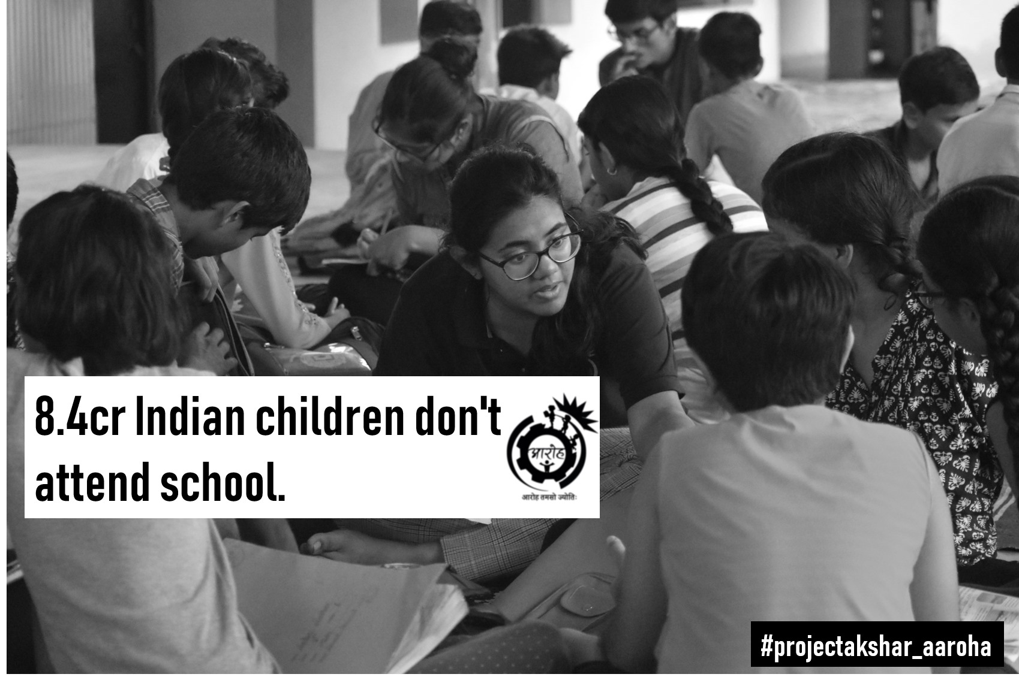
AKSHAR

Slide 4
Project Akshar aims to educate underpriviledged children at different centres and impart them with elementary knowledge before they acquire enough competence to be endorsed for the next project, project Paathshala.

Slide 5
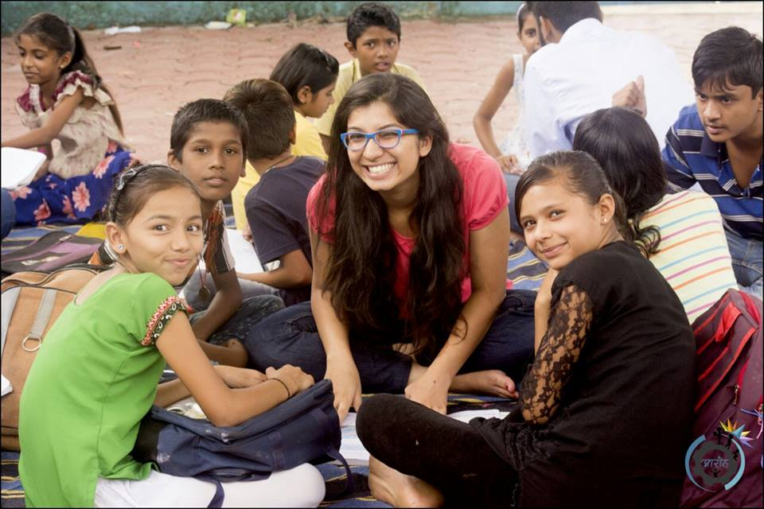

Slide 6
PAATHSHALA
Works to enable meritorious students of Project Akshar by admitting them to decent private institutions and funding the rest of their studies.
This project has already benefited FIFTEEN brilliant slum children and is looking forward for more .

Slide 7
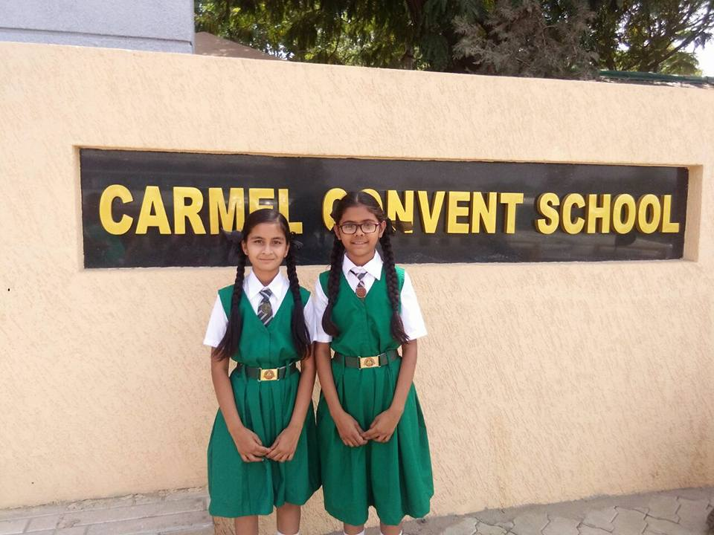

Slide 8
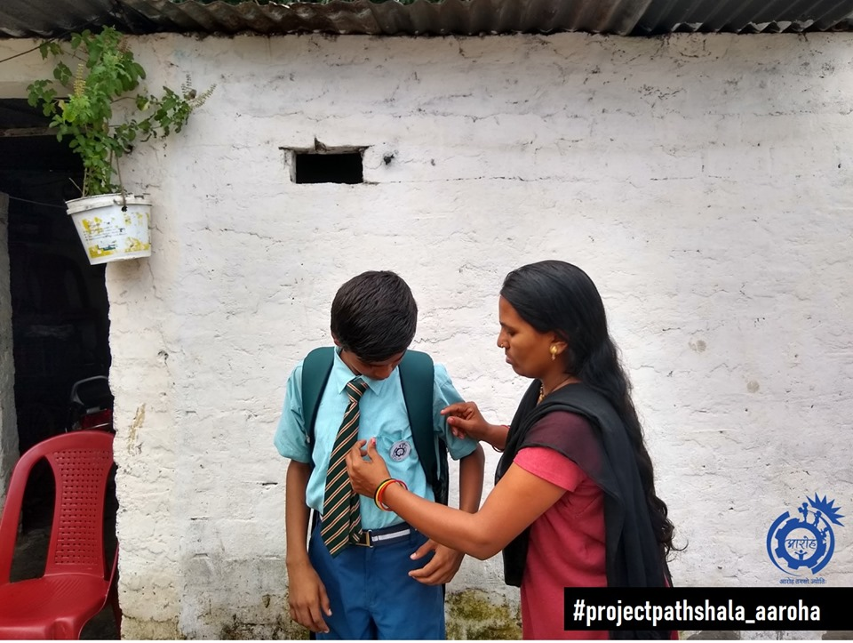

Slide 9


Slide 10
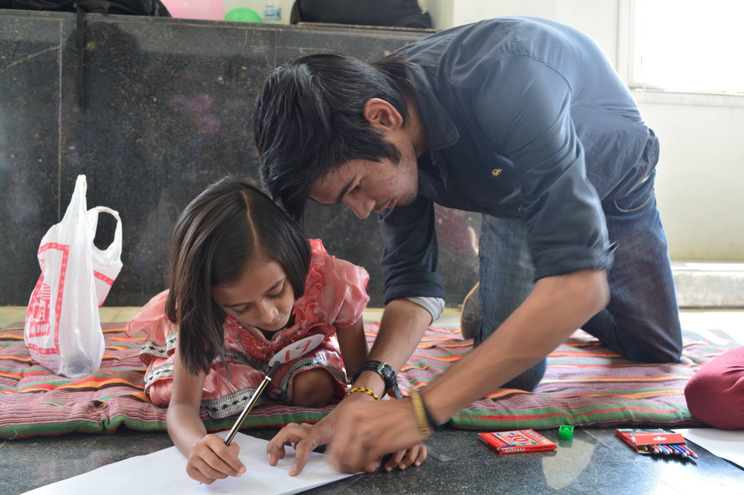
AAKAR

Slide 11
Project Aakar is consigned for overall development of poor children from the slums.
Procure them with finese in specific interests other than from academic outlook. Various activities and workshops are conducted on weekly basis for the same.

Slide 12
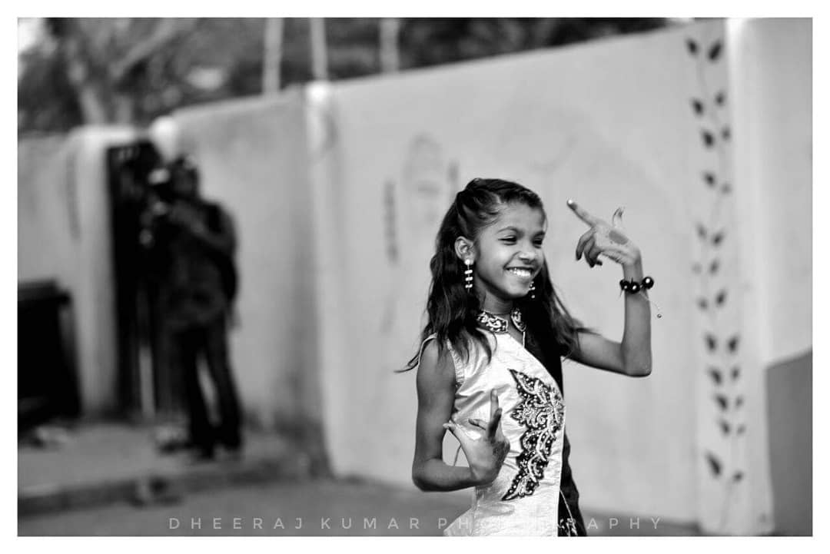
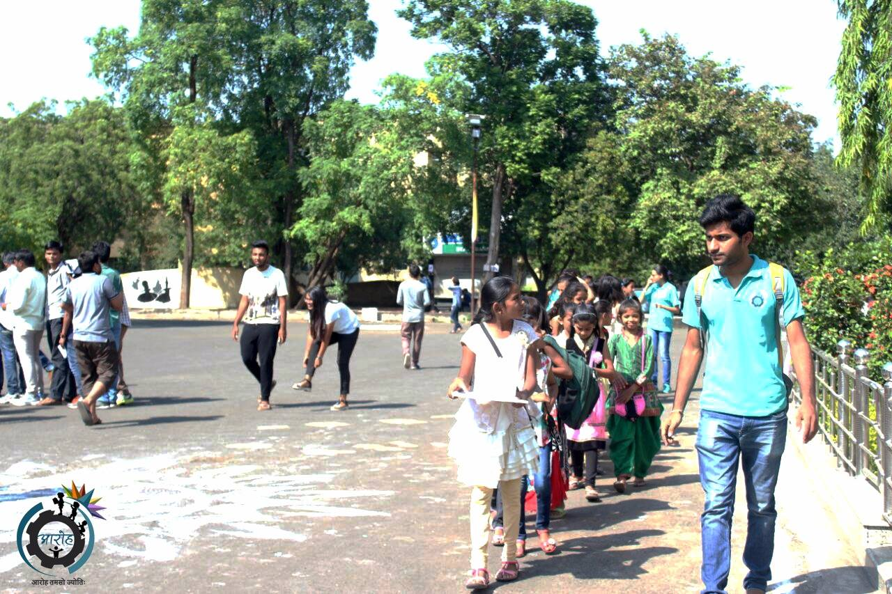

Slide 13
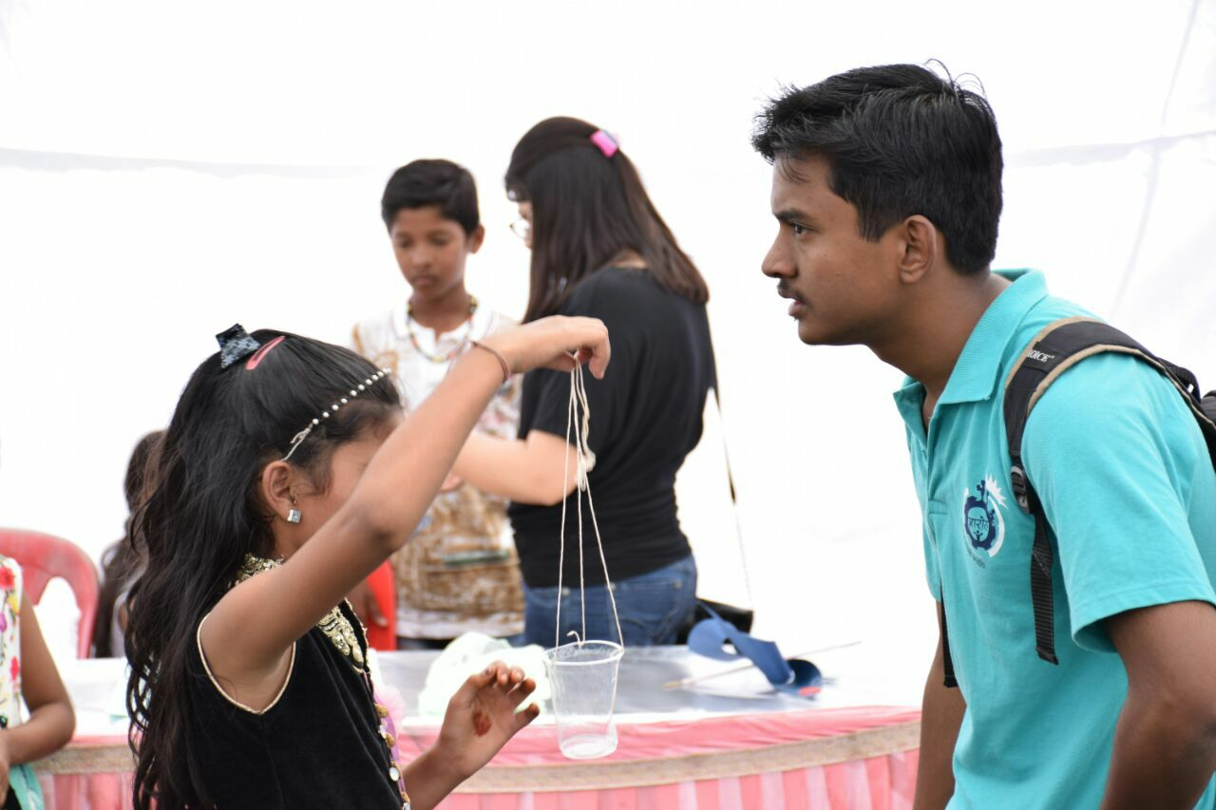

Slide 14
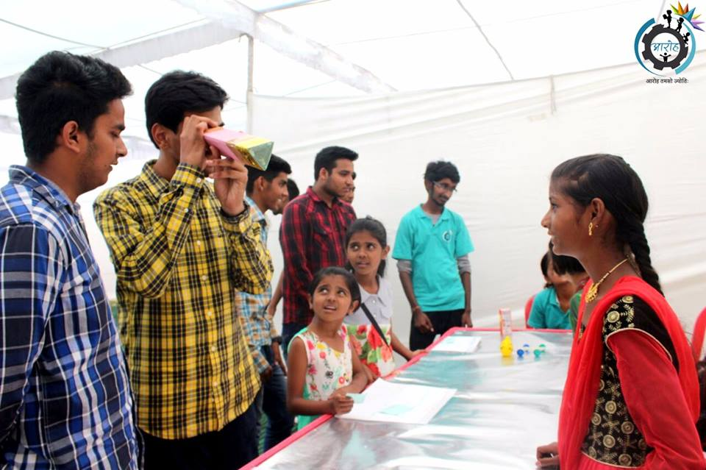

Slide 15
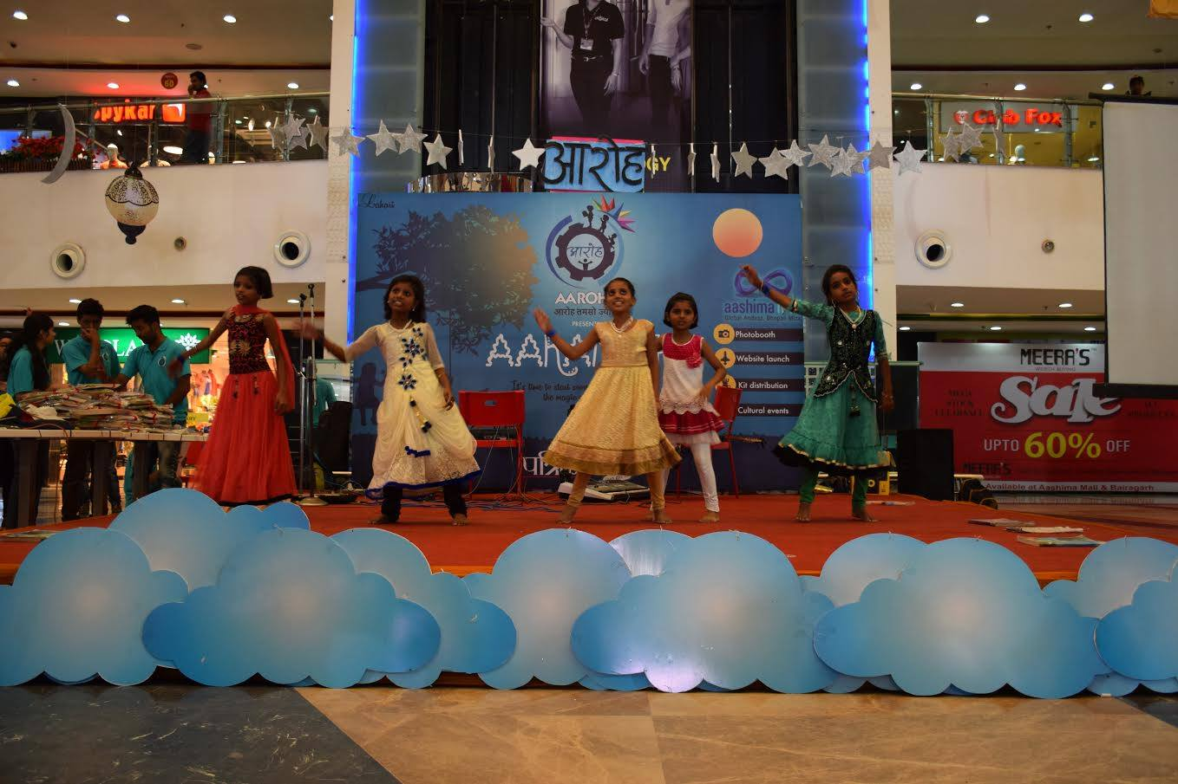
AANAND

Slide 16
Under Aanand , educational and fun trips are organized occasionally to keep them captivated throughout the learning process.
There are events, coordinated to provide them with a platform to enhance and showcase their flair in outside activities as well .

Slide 17
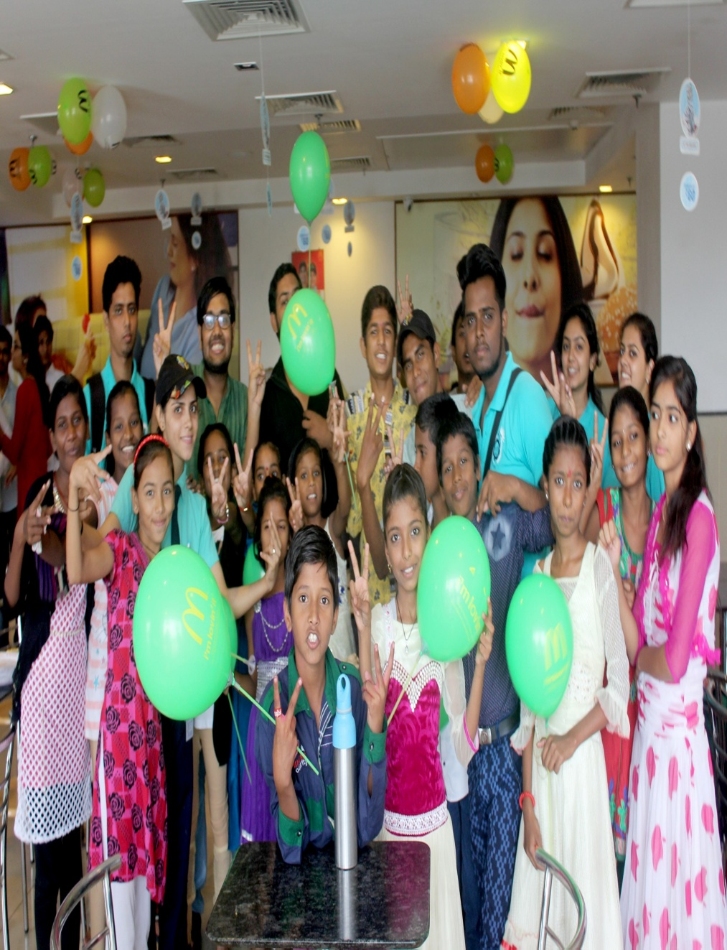
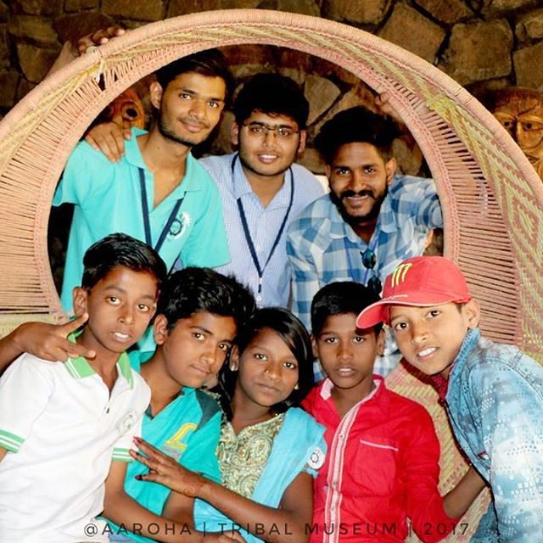

Slide 18
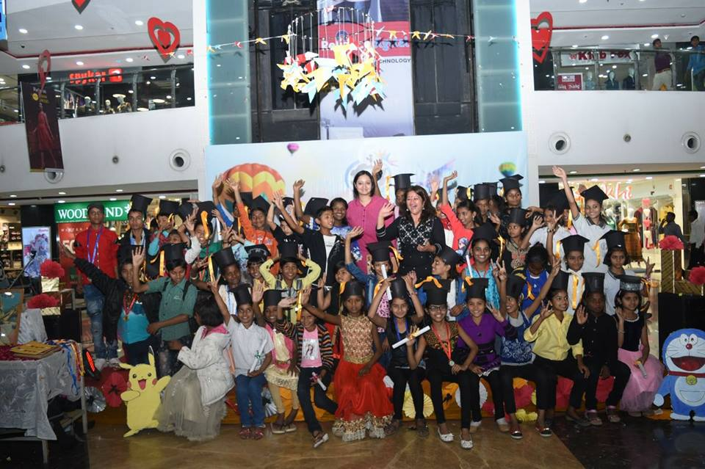

Slide 19
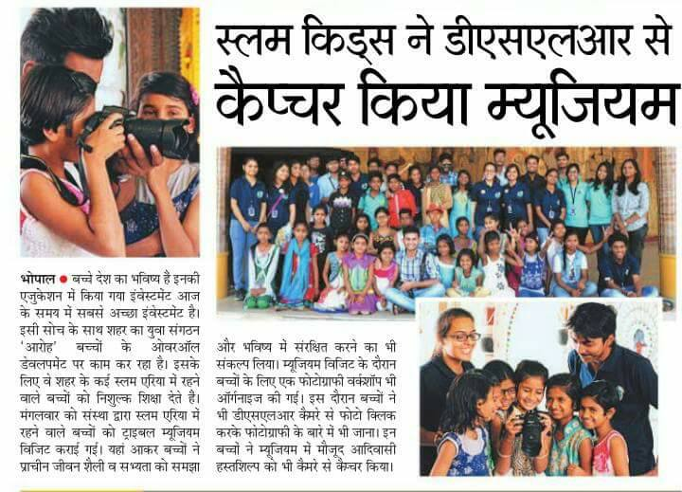
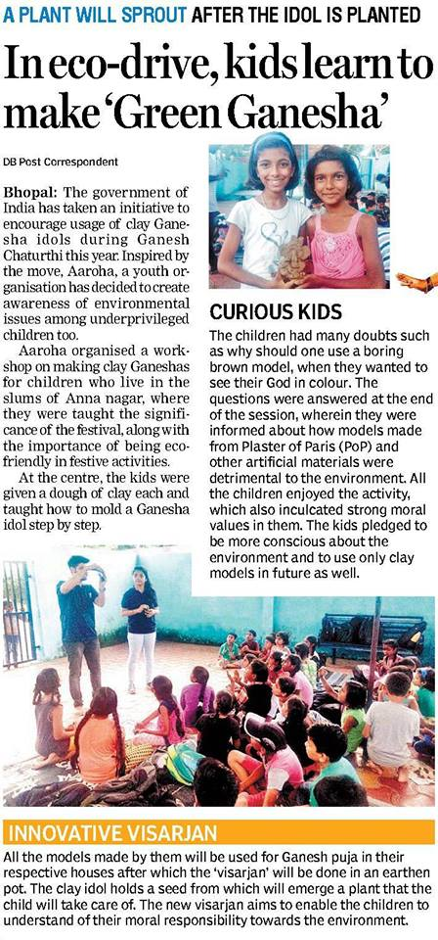

Slide 20
PRADAAN
Under project PRADAAN we provide stationary items including books, notebooks, pens etc. and also provide school uniforms to the students in private schools through the project paathshala .

Slide 21
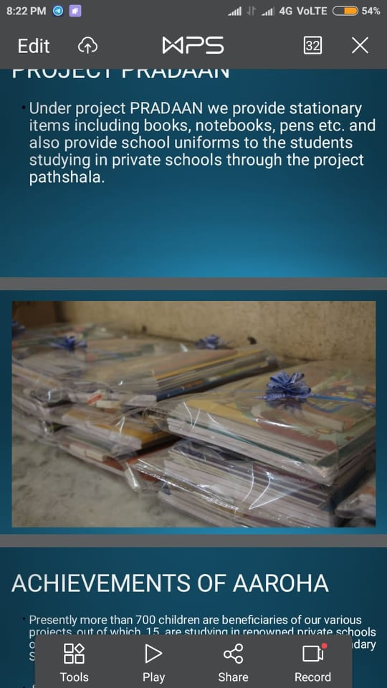

Slide 22
ACHIEVEMENTS OF AAROHA
Presently more than 700 children are beneficiaries of our various projects , out of 15 are studying in reowned private schools of bhopal such as Carmel Convent Secondary School.
SUJEET, who was earlier a newspaper seller is now studying in Model Higher Secondary School while Rajneesh, is studying in Hema Higher Secondary School as a result of our efforts and their determination.

Slide 23
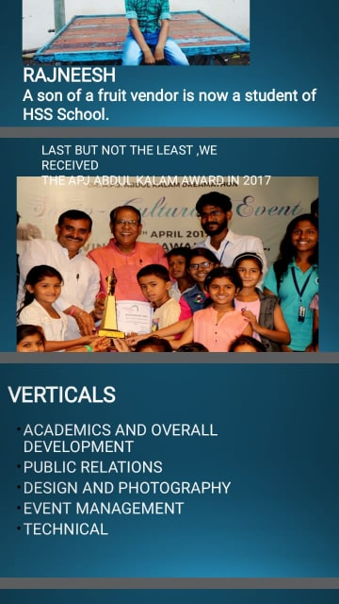

Slide 24
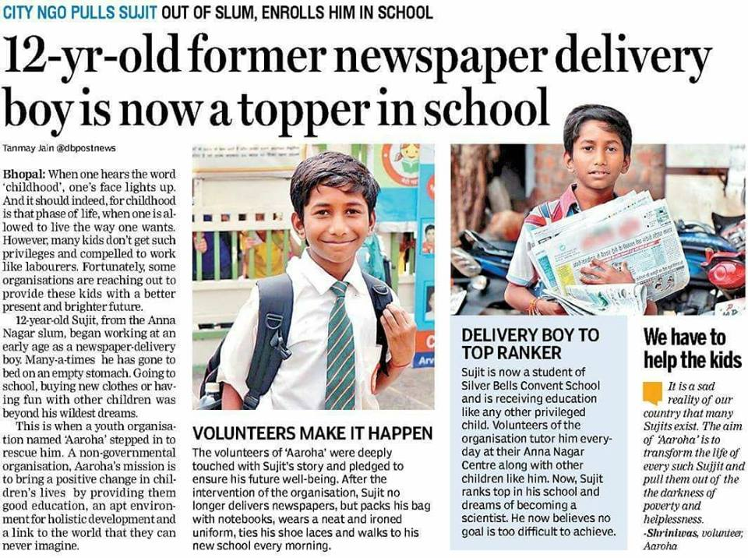

Slide 25
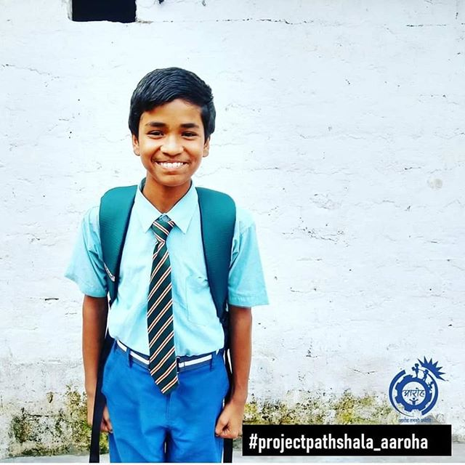
Rajneesh, son of a fruit vendor is now a student of HSS school.

Slide 26
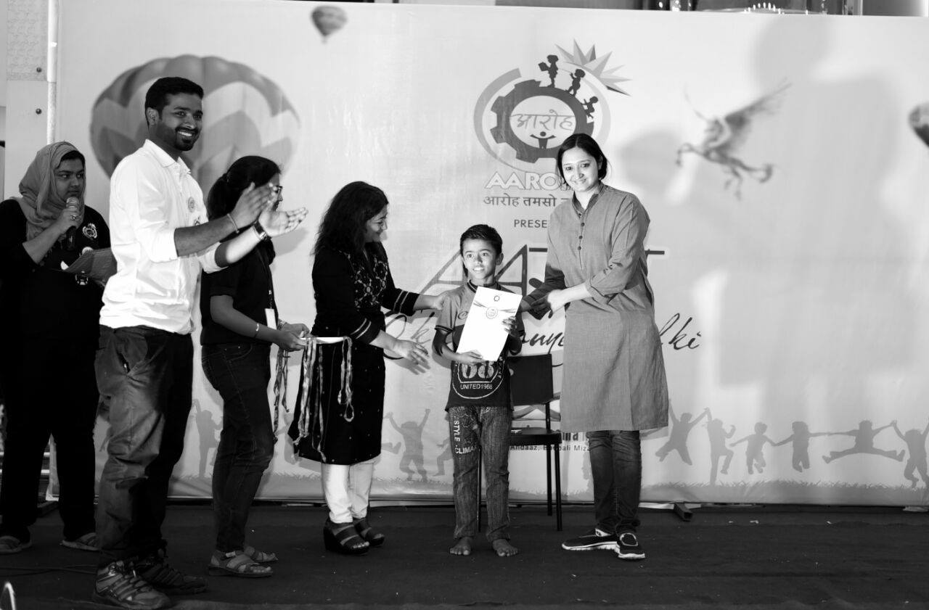

Slide 27
VERTICALS
ACADEMICS AND OVERALL DEVELOPMENT
PUBLIC RELATIONS
DESIGN AND PHOTOGRAPHY
EVENT MANAGEMENT
TECHNICAL

Slide 28
ACADEMIC AND OVERALL DEVELOPMENT
Visiting the centre once a week to teach the children.
Academic
Etiquettes.
Personality development
Monitoring progress of the children.
Maintaining a healthy environment at the centre.

Slide 29
PUBLIC RELATIONS
Planning publicity strategies and campaign.
Dealing with enquiries from the public, the press and related organization.
Finding sponsorships for the children’s education.

Slide 30
DESIGN AND PHOTOGRAPHY
Designing posters for events.
Photography for events and press releases.

Slide 31
EVENT MANAGEMENT
Preparing for events.
Fundraising
Extra curricular activities.
Promotional events
Festivals at the center.

Slide 32
TECHNICAL
Web Development
App Development
Google Doc forms

Slide 33
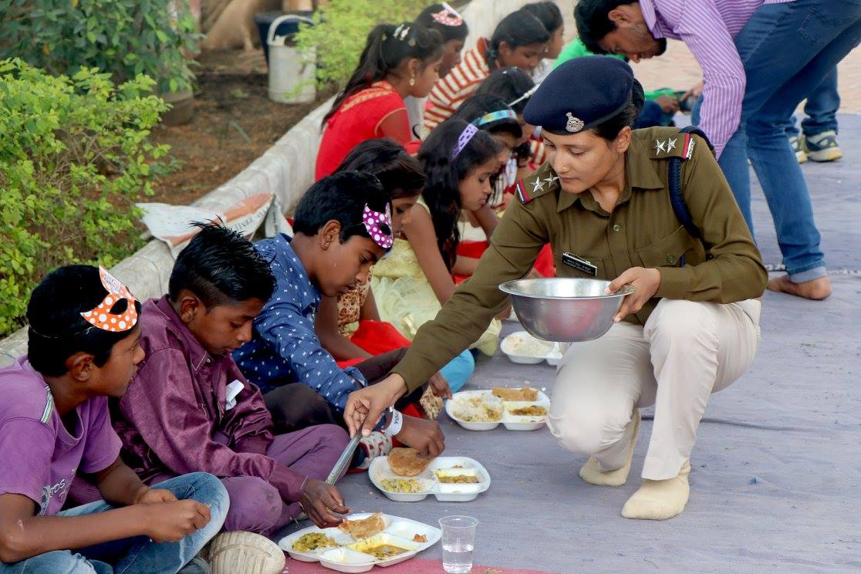

Slide 34
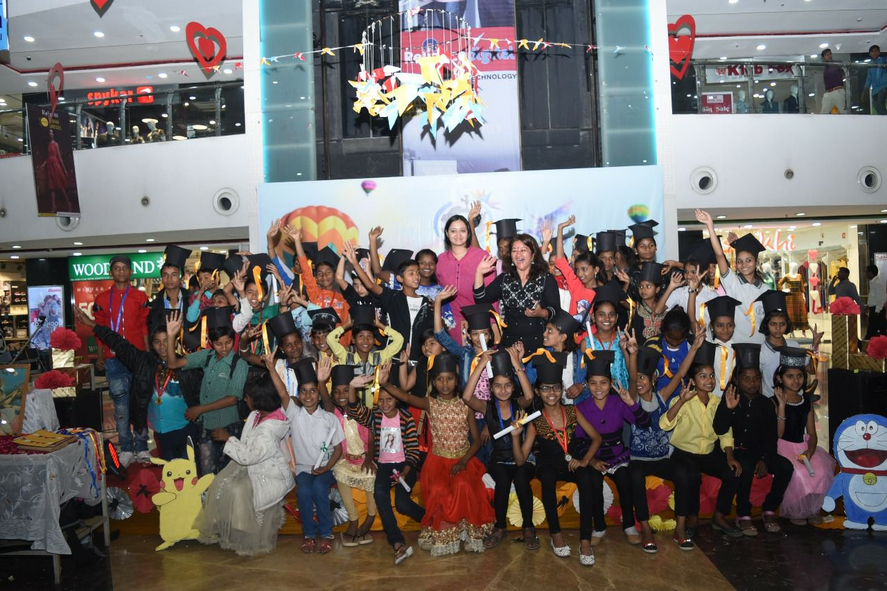

Slide 35
